Slide 1
Growth Mindset & Sequential Logic
Growth vs. Fixed Mindset, Introduction to Sequential Logic, Representing Time in Hardware, The Data Flip-Flop (DFF)

Slide 2
Lecture Outline
Growth vs. Fixed Mindset
  Setting SMART Goals
Introduction to Sequential Logic
  The Problem of Combinational Logic
  Autopilot Control Circuit Example
Representing Time in Hardware
  Clock Signals and Units of Time in Hardware
The Data Flip-Flop (DFF)
  Implementation and Examples

Slide 3

Growth vs. Fixed Mindset

Slide 4
Setting SMART Goals
S – Be specific, simple and significant.
M – Make sure your goals are measurable. How many times within a week, month, the quarter do you want to do x goal?
A – Make sure your goals are achievable. Is your goal within your scope of control?
R – Be realistic and reasonable.
T – Be time-bound. When will you accomplish your goal?

Slide 5
SMART Goals Group Discussion
WINTER QUARTER
GOALS
SPHERE OF CONTROL
SMART GOAL
FRAMEWORK
What are skills, practices or habits that are not strengths YET?
Getting a 4.0 in a course
vs.
Attending course
office hours
S — Specific
M — Measurable
A — Achievable
R — Realistic
T — Timebound
Attending CSE 390B
office hours at least
5x this quarter
(or once every other week)

Slide 6
Lecture Outline
Growth vs. Fixed Mindset
  Setting SMART Goals
Introduction to Sequential Logic
  The Problem of Combinational Logic
  Autopilot Control Circuit Example
Representing Time in Hardware
  Clock Signals and Units of Time in Hardware
The Data Flip-Flop (DFF)
  Implementation and Examples

Slide 7
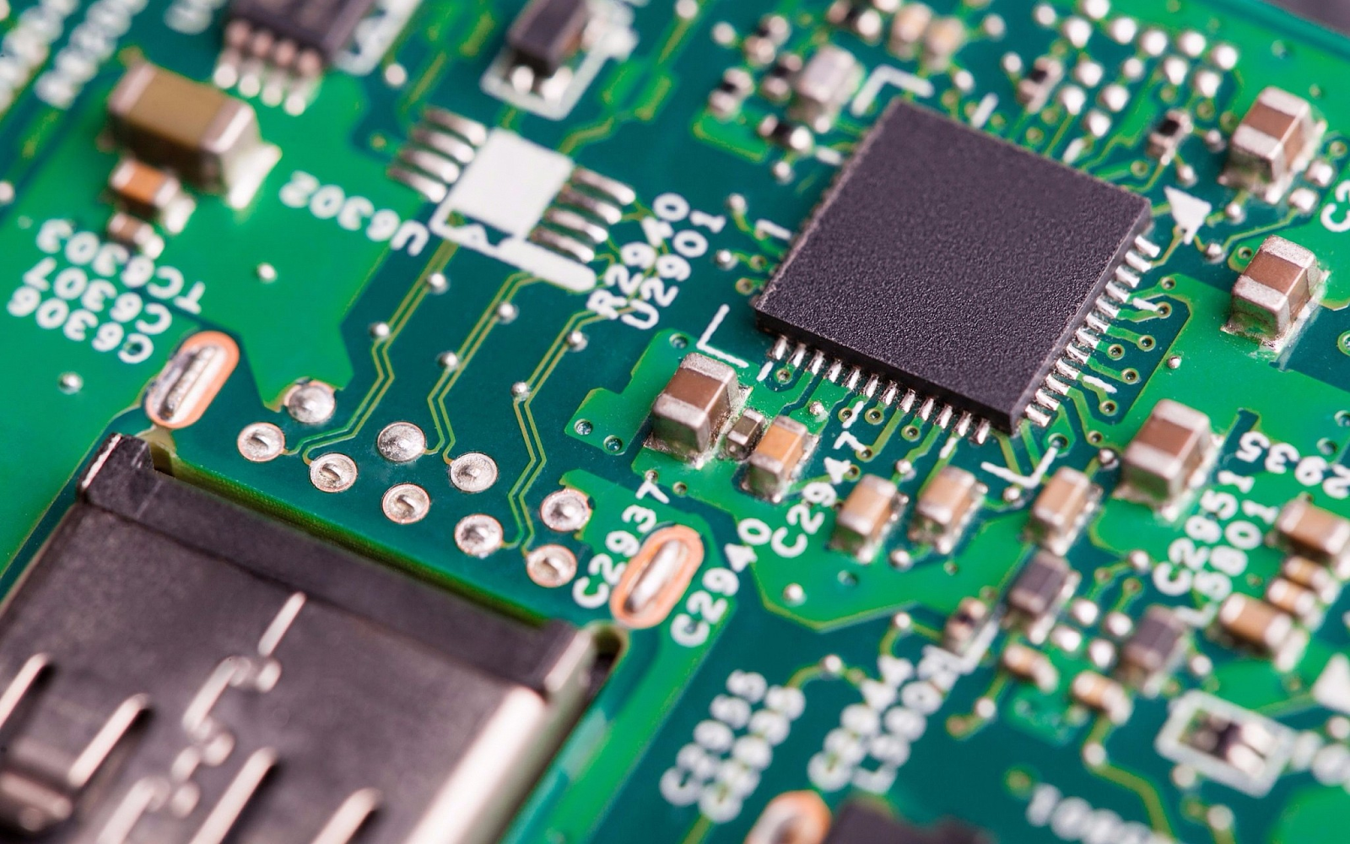
Why Consider Time Now?
Needed for our abstraction
  We need to talk about hardware maintaining state for memory
  We need vocabulary to talk about time
Needed for our implementation
  Physical implementations of chips cannot be instantaneous
  We need to account for physical delays in signal propagation

Slide 8

The Problem with Combinational Logic
Consider the following circuit:
Let’s assume that a=0, b=1, and c=0
  The output should be 1
What’s the result if we change b=0 and c=1?
  The result should still be 1
  However, out is briefly 0 if we change c first

Slide 9
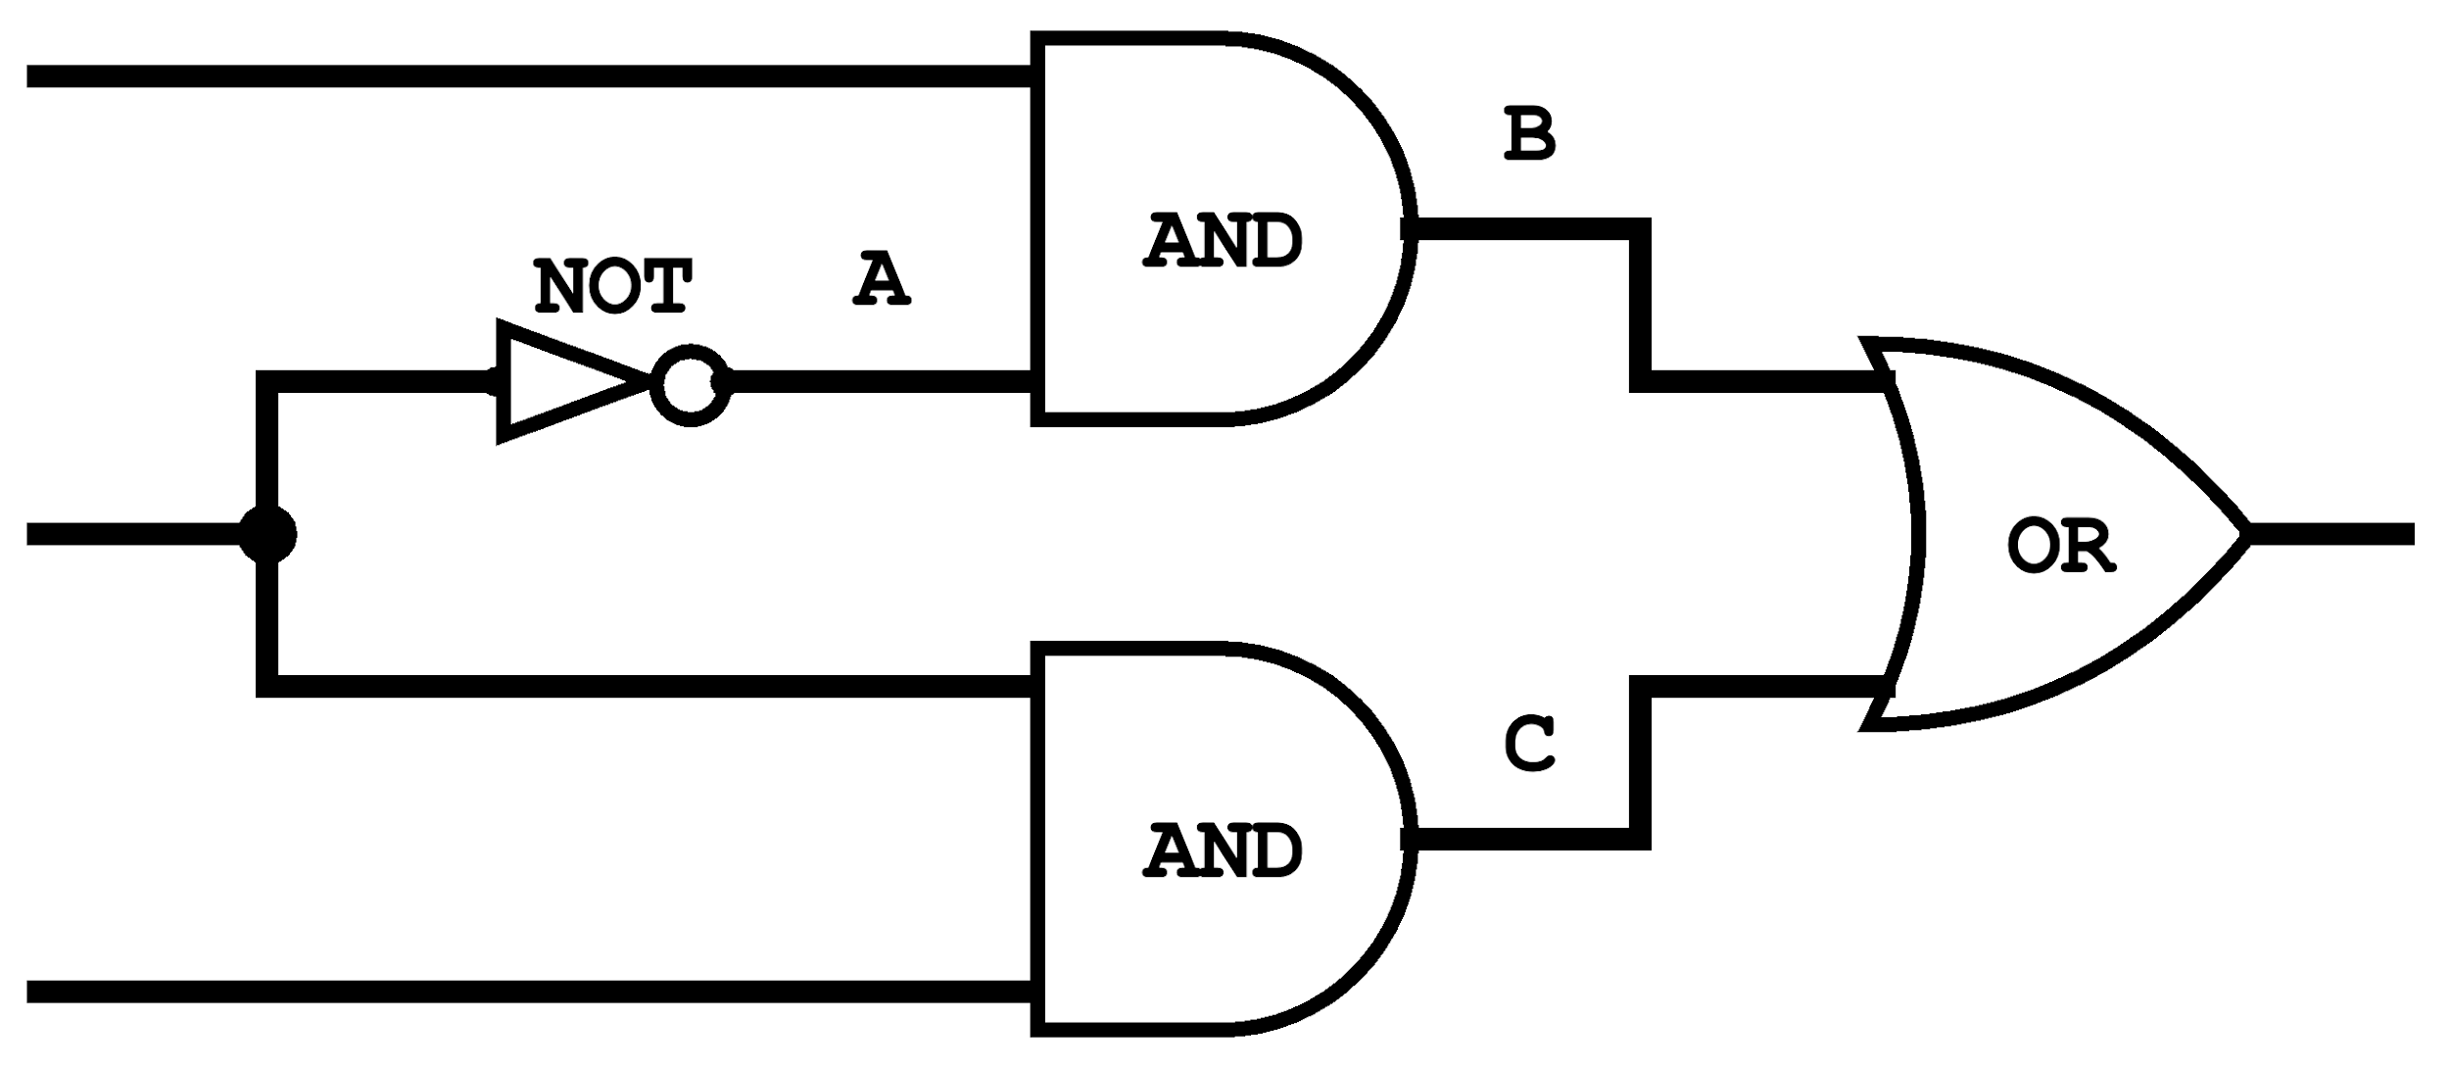
Autopilot Control Circuit Example
Consider this autopilot control circuit:
  Either the pilot or copilot is flying at any time
  The pilot and copilot can separately request autopilot
  Only the person flying can request autopilot
Copilot Autopilot Request (CAR)
Pilot Flying (PF)?
Autopilot Engaged (AE)
Pilot Autopilot Request (PAR)
Thanks to Justin Hsia for this example!

Slide 10
Autopilot Control Circuit Example
Consider this autopilot control circuit:
  Either the pilot or copilot is flying at any time
  The pilot and copilot can separately request autopilot
  Only the person flying can request autopilot
Let’s assume every logic gate takes 1ms to compute
  For example, if an input changes at t=4ms, the gate will only output the new result at t=5ms
Copilot Autopilot Request (CAR)
Pilot Flying (PF)?
Autopilot Engaged (AE)
Pilot Autopilot Request (PAR)
Thanks to Justin Hsia for this example!

Slide 11
Autopilot Control Circuit Example
Copilot Autopilot Request (CAR)
Pilot Flying (PF)?
Autopilot Engaged (AE)
Pilot Autopilot Request (PAR)
CAR | 1 | 1 | 1 | 1 | 1 | 1
PF | 1 | 0 | 0 | 0 | 0 | 0
PAR | 1 | 1 | 1 | 1 | 1 | 1
A | 0
B | 0
C | 1
AE | 1
0ms
1ms
2ms
3ms
4ms
5ms
6ms

Slide 12
Autopilot Control Circuit Example
Copilot Autopilot Request (CAR)
Pilot Flying (PF)?
Autopilot Engaged (AE)
Pilot Autopilot Request (PAR)
CAR | 1 | 1 | 1 | 1 | 1 | 1
PF | 1 | 0 | 0 | 0 | 0 | 0
PAR | 1 | 1 | 1 | 1 | 1 | 1
A | 0
B | 0
C | 1
AE | 1
??
0ms
1ms
2ms
3ms
4ms
5ms
6ms

Slide 13
Autopilot Control Circuit Example
Copilot Autopilot Request (CAR)
Pilot Flying (PF)?
Autopilot Engaged (AE)
Pilot Autopilot Request (PAR)
CAR | 1 | 1 | 1 | 1 | 1 | 1
PF | 1 | 0 | 0 | 0 | 0 | 0
PAR | 1 | 1 | 1 | 1 | 1 | 1
A | 0 | 0
B | 0
C | 1
AE | 1
0ms
1ms
2ms
3ms
4ms
5ms
6ms

Slide 14
Autopilot Control Circuit Example
Copilot Autopilot Request (CAR)
Pilot Flying (PF)?
Autopilot Engaged (AE)
Pilot Autopilot Request (PAR)
CAR | 1 | 1 | 1 | 1 | 1 | 1
PF | 1 | 0 | 0 | 0 | 0 | 0
PAR | 1 | 1 | 1 | 1 | 1 | 1
A | 0 | 0 | ?
B | 0
C | 1
AE | 1
0ms
1ms
2ms
3ms
4ms
5ms
6ms

Slide 15
Autopilot Control Circuit Example
Copilot Autopilot Request (CAR)
Pilot Flying (PF)?
Autopilot Engaged (AE)
Pilot Autopilot Request (PAR)
CAR | 1 | 1 | 1 | 1 | 1 | 1
PF | 1 | 0 | 0 | 0 | 0 | 0
PAR | 1 | 1 | 1 | 1 | 1 | 1
A | 0 | 0 | 1
B | 0
C | 1
AE | 1
0ms
1ms
2ms
3ms
4ms
5ms
6ms

Slide 16
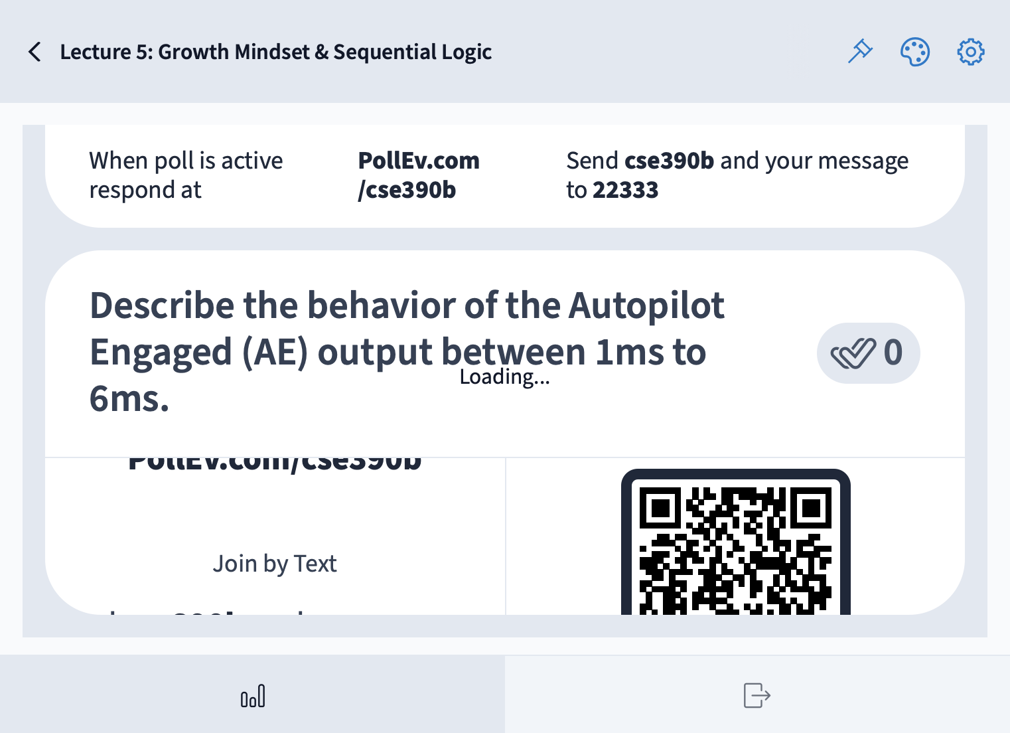
Describe the behavior of the Autopilot Engaged (AE) output between 1ms to 6ms.
Copilot Autopilot Request (CAR)
Pilot Flying (PF)?
Autopilot Engaged (AE)
Pilot Autopilot Request (PAR)
CAR | 1 | 1 | 1 | 1 | 1 | 1
PF | 1 | 0 | 0 | 0 | 0 | 0
PAR | 1 | 1 | 1 | 1 | 1 | 1
A | 0 | 0 | 1
B | 0
C | 1
AE | 1
0ms
1ms
2ms
3ms
4ms
5ms
6ms

Slide 17
Autopilot Control Circuit Example
Copilot Autopilot Request (CAR)
Critical Path
Pilot Flying (PF)?
Autopilot Engaged (AE)
Pilot Autopilot Request (PAR)
CAR | 1 | 1 | 1 | 1 | 1 | 1
PF | 1 | 0 | 0 | 0 | 0 | 0
PAR | 1 | 1 | 1 | 1 | 1 | 1
A | 0 | 0 | 1 | 1 | 1 | 1
B | 0 | 0 | 0 | 1 | 1 | 1
C | 1 | 1 | 0 | 0 | 0 | 0
AE | 1 | 1 | 1 | 0 | 1 | 1
0ms
1ms
2ms
3ms
4ms
5ms
6ms

Slide 18
Combinational vs. Sequential Logic
So far, we have ignored “time” in our circuits
Our chips used combinational logic
  When given inputs, the chip computes its output instantaneously
  The output is a function of the current inputs, with no memory of previous events
Today, we’ll start exploring what happens when we consider time, ultimately building to sequential logic

Slide 19
What is Sequential Logic?
Sequential logic incorporates time in hardware
Output depends on present value of its input signals and a sequence of past inputs
Sequential logic resolves the problem introduced with combinational logic
  Does so by adding a delay for the entire circuit before evaluating the result
  All the circuits will be evaluated between one clock cycle and the output will be evaluated at the end of the clock cycle

Slide 20
Combinational vs. Sequential Abstraction
Clock Signal
1
0
Combinational: a function of the current inputs
in
a
b
c
d
e
out
f(a)
f(b)
f(c)
f(d)
f(e)
Sequential: a function of previous inputs (has “memory”)
in
a
b
c
d
e
out
f(a)
f(b)
f(c)
f(d)
t=0
t=1
t=2
t=3
t=4

Slide 21
Lecture Outline
Growth vs. Fixed Mindset
  Setting SMART Goals
Introduction to Sequential Logic
  The Problem of Combinational Logic
  Autopilot Control Circuit Example
Representing Time in Hardware
  Clock Signals and Units of Time in Hardware
The Data Flip-Flop (DFF)
  Implementation and Examples

Slide 22
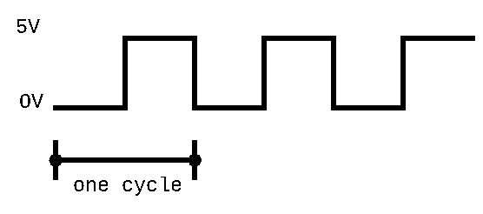
Representing Time: Clock Signals
We physically represent time in hardware with a clock signal
  A clock signal changes its frequency at a set time rate
  Alternates between a low signal and a high signal of equal length
A cycle is a period of time between a low and high signal
  Represents one unit of time in hardware
  We can change how long a unit of time is by alternating the length of the low and high signals

Slide 23
Physical Timekeeping
Hardware keeps track of time using an alternating signal
  Creates the idea of discrete time: state changes only occur in discrete intervals, right when signal alternates
Physical Time
Clock Signal
1
0

Slide 24
Physical Timekeeping
Hardware keeps track of time using an alternating signal
  Creates the idea of discrete time: state changes only occur in discrete intervals, right when signal alternates
Physical Time
Clock Signal
1
0
t=0
t=1
t=2
t=3
t=4
Discrete Time Intervals

Slide 25

Adding a Clock: Ideal
We want this behavior from a simple, combinational Not gate:
Clock Signal
1
0
1
in
0
1
out
0
t=0
t=1
t=2
t=3
t=4

Slide 26
Adding a Clock: Reality
Combinational logic may be incorrect for a period immediately after inputs change
  Computation delays (logic gates) and propagation delays (wires)
Clock Signal
1
0
In the autopilot example, this arrow would represent the 3ms of uncertainty after inputs change
1
in
0
1
out
0
t=0
t=1
t=2
t=3
t=4

Slide 27
Adding a Clock: Clock Cycles
Choose a clock cycle length slightly longer than the delays
> 3ms
Clock Signal
1
0
1
in
0
1
out
0
t=0
t=1
t=2
t=3
t=4

Slide 28
Adding a Clock: Abstraction
If we use a long enough clock cycle, we can pretend that combinational chips (like Not) work instantly
Clock Signal
1
0
1
in
0
1
out
0
t=0
t=1
t=2
t=3
t=4

Slide 29
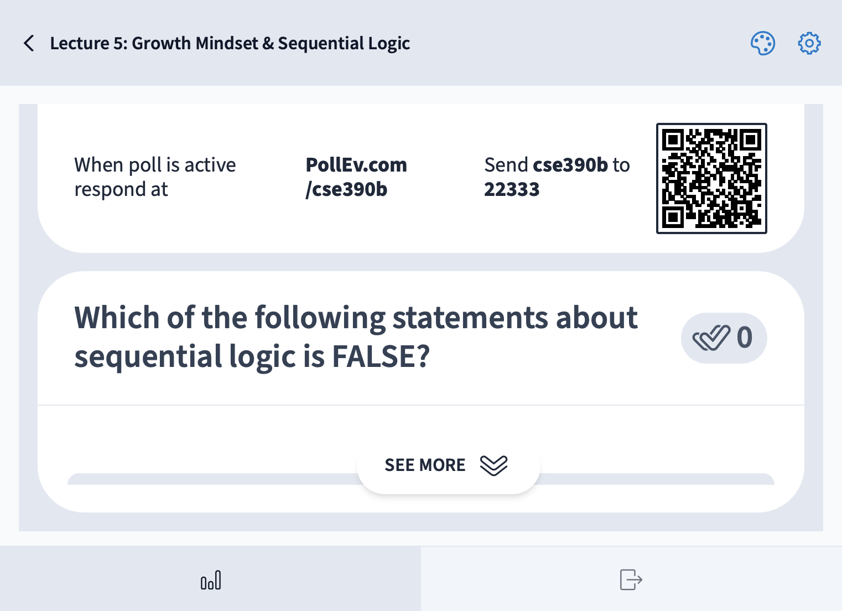
Which of the following statements about sequential logic is FALSE?
We represent time with a clock signal that alternates between high and low signals
The DFF allows us to reuse outputs as inputs in a circuit
The outputs for a DFF at time t=2 is determined by the inputs at time t=3
Sequential logic is important because it addresses slight delays caused in circuit gates
We’re lost…

Slide 30
Lecture Outline
Growth vs. Fixed Mindset
  Setting SMART Goals
Introduction to Sequential Logic
  The Problem of Combinational Logic
  Autopilot Control Circuit Example
Representing Time in Hardware
  Clock Signals and Units of Time in Hardware
The Data Flip-Flop (DFF)
  Implementation and Examples

Slide 31
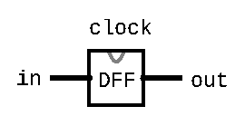
The Data Flip-Flop Gate
Simplest state-keeping component
  1-bit input, 1-bit output
  Wired to the clock signal
  Always outputs its previous input: out(t) = in(t-1)
Implementation: a gate that can flip between two stable states (remembering 0 vs. remembering 1)
  Gates with this behavior are “Data Flip Flops” (DFFs)

Slide 32
Aside: Treating the DFF as a Primitive
Disclaimer: DFFs can be made from Nand gates exclusively
  But requires wiring them together in a “messy” loop that the hardware simulator can’t simulate and isn’t very educational
For simplicity, we will treat the DFF as a primitive in the projects
  Just like Nand, you can use the built-in implementation

Slide 33
Data Flip-Flop (DFF) Behavior
1
Clock Signal
0
1
in
0
out
1
0
t=0
t=1
t=2
t=3
t=4

Slide 34
Sequential Chips
A category of chips that utilize the clock signal, in addition to any combinational logic
Capable of:
  Maintaining state
  Optionally, acting on that state and the current inputs
    Can incorporate combinational logic as well
Constructed from:
  DFFs
  Combinational logic (which is entirely constructed from Nand)

Slide 35
Sequential Chips
output(t) = f(state(t-1), input(t))
DFF
Combinational Logic
f
input
DFF
output
DFF

Slide 36
D Flip-Flop: Time Series
DFF Specification:
out(t) = in(t-1)
in | 0 | 0 | 1 | 1 | 0 | 1 | 0 | ...
out | 0 | 0 | 0 | 1 | 1 | 0 | 1 | ...
time | t=0 | t=1 | t=2 | t=3 | t=4 | t=5 | t=6 | ...
Example: out(t=3) = in(t=2)

Slide 37
DFF Example 1: Specification
Example specification:
out(t) = Xor(a(t-1), b(t-1))
Takes two inputs, a and b, and outputs the Xor of them
  Note that out at time t is determined by a and b at time t-1
  We will need to use a DFF
Exercise: Draw out the corresponding circuit diagram and HDL implementation

Slide 38
DFF Example 1: Time Series
Example specification:
out(t) = Xor(a(t-1), b(t-1))
Example: out(t=3) = Xor(a(t=2), b(t=2))
a | 0 | 0 | 1 | 1 | 1 | 0 | 0 | ...
b | 0 | 1 | 0 | 1 | 1 | 1 | 0 | ...
out | 0 | 0 | 1 | 1 | 0 | 0 | 1 | ...
time | t=0 | t=1 | t=2 | t=3 | t=4 | t=5 | t=6 | ...

Slide 39
DFF Example 1: Circuit Diagram & HDL
Example specification:
out(t) = Xor(a(t-1), b(t-1))
Circuit diagram:
HDL:

Slide 40
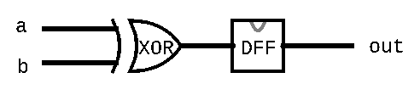
DFF Example 1: Circuit Diagram & HDL
Example specification:
out(t) = Xor(a(t-1), b(t-1))
Circuit diagram:
HDL:
CHIP Example1 {
IN a, b;
OUT out;
PARTS:
Xor(a=a, b=b, out=xorout);
DFF(in=xorout, out=out);
}

Slide 41
DFF Example 2: Specification
Example specification:
out(t) = Xor(out(t-1), in(t-1))
Notice how the specification uses out(t-1) as an input for out(t)
  Implies the necessity of circular wiring, separated by a DFF
Exercise: Draw out the corresponding circuit diagram and HDL implementation

Slide 42
DFF Example 2: Time Series
Example specification:
out(t) = Xor(out(t-1), in(t-1))
Example: out(t=1) = Xor(in(t=0), out(t=0))
in | 0 | 0 | 1 | 1 | 1 | 0 | 0 | ...
out | 0 | 0 | 0 | 1 | 0 | 1 | 1 | ...
time | t=0 | t=1 | t=2 | t=3 | t=4 | t=5 | t=6 | ...

Slide 43
DFF Example 2: Circuit Diagram & HDL
Example specification:
out(t) = Xor(out(t-1), in(t-1))
Circuit diagram:
HDL:

Slide 44
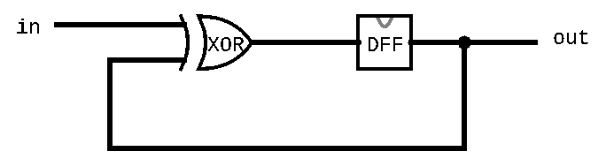
DFF Example 2: Circuit Diagram & HDL
Example specification:
out(t) = Xor(out(t-1), in(t-1))
Circuit diagram:
HDL:
CHIP Example2 {
IN in;
OUT out;
PARTS:
Xor(a=in, b=prevout, out=xorout);
DFF(in=xorout, out=prevout, out=out);
}

Slide 45
DFF Example 3: Specification
Example specification:
out(t) = And(Not(out(t-1)), in(t-1))
Exercise: Draw out the corresponding circuit diagram and HDL implementation

Slide 46
DFF Example 3: Time Series
Example specification:
out(t) = And(Not(out(t-1)), in(t-1))
Example:
out(t=1) = And(Not(out(t=0)), in(t=0))
in | 1 | 1 | 0 | 1 | 1 | 0 | 0 | ...
out | 0 | 1 | 0 | 0 | 1 | 0 | 0 | ...
time | t=0 | t=1 | t=2 | t=3 | t=4 | t=5 | t=6 | ...

Slide 47
DFF Example 3: Circuit Diagram & HDL
Example specification:
out(t) = And(Not(out(t-1)), in(t-1))
Circuit diagram:
HDL:

Slide 48
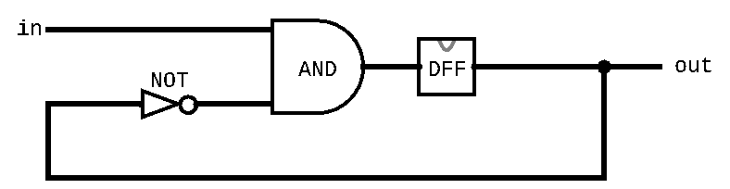
DFF Example 3: Circuit Diagram & HDL
Example specification:
out(t) = And(Not(out(t-1)), in(t-1))
Circuit diagram:
HDL:
CHIP Example3 {
IN in;
OUT out;
PARTS:
Not(in=prevout, out=notprevout);
And(a=in, b=notprevout, out=andout);
DFF(in=andout, out=prevout, out=out);
}

Slide 49
Lecture 5 Reminders
Project 3 due this Friday (1/19) at 11:59pm
Amy has office hours tomorrow at 1:30pm in CSE2 151
  Feel free to post your questions on the Ed board as well
Eric will be out of town during Week 10
  We will still have class together, more details to come

